Slide 1
EFI Application Development
Intel Corporation
Software and Solutions Group
Copyright © 2006-2008 Intel Corporation
Notes:
Let’s talk about EFI applications and how to develop them

Slide 2
Agenda
Introduction
EFI Applications
EDK DUET
EFI Toolkit
3rd Party Libraries
Notes:
Our agenda is to introduce you to EFI applications and what the are used for
Talk about the EFI shell and the role it plays in EFI application and usage
Introduce you to both Intel supplied and 3rd party libraries that provide a rich set of functions to speed your development

Slide 3
What do UEFI Applications do?
Introduction
Extend firmware abstractly
  Without hardware or OS dependence
Portable across platforms
  IA32, IA64, Intel-64, XScale, Apple*, NT32 emulator
Enable rapid application development
Notes:
What is an Application.
Applications written to this specification are loaded by the Boot Manager or by other UEFI
applications. To load an application the firmware allocates enough memory to hold the image,
copies the sections within the application to the allocated memory, and applies the relocation fix-ups
needed. Once done, the allocated memory is set to be the proper type for code and data for the
image. Control is then transferred to the application’s entry point. When the application returns from
its entry point, or when it calls the Boot Service Exit(), the application is unloaded from memory
and control is returned to the UEFI component that loaded the application.

Slide 4
Application Execution
Introduction
Entry Point
UEFI Loader
Body of Application
(Work Done Here)
Exit Application

Slide 5
What is an EFI Application?
Introduction
An EFI Loadable Image
  Loaded by EFI loader just like drivers
  Does not register protocols like drivers do
  Consumes protocols
  Typically user driven (exits when task completed)
  Same set of interfaces available as drivers have
Can be used for
  Platform diagnostics
  Factory diagnostics
  Utilities
  Driver prototyping
  ‘Platform’ applications
Notes:
EFI Applications are just like EFI drivers, they are loadable images.
Their difference lies in that they typically do not register protocols like a driver does. They typically consume protocols to do a user driven task.
The same set of EFI or firmware interfaces are available to applications that drivers have. Thus they are useful for driver prototyping since they can be quickly loaded from the EFI shell to test the usage of an interface and help you in driver development.
Their usages include factory testing, platform diagnostics (no OS required), and other various pre-boot applications you can think of where the need to do some operation without an OS would be useful.

Slide 6
Driver vs. Application
Introduction
 | Driver | Application
Loaded by: | EFI Loader | EFI Loader
Interfaces available: | ALL | ALL
Consume protocols? | YES | YES
Produce protocols? | YES | NO
Typically driven by? | System | User
Typical use | Support HW | Any

Slide 7
EFI Shell
EFI Shell
An EFI Application
Interactive Console Interface
Application Launch
Load EFI Drivers
Scripting Capability
Automatic execution of startup script file
Console redirection to files
Notes:
The EFI shell is an EFI application that provides an interactive interface that allows you to launch EFI applications as well as load EFI drivers. The shell is very similar in capabilities to the DOS command line interface and the UNIX shell. Loading of EFI drivers from the shell helps speed up your development activities since you don’t need to put them into the FLASH part to test them. You simply load them from the shell.
The shell provides scripting capabilities that allows you to write scripts to automate platform operations. A start batch file can be used to run various commands each time the shell is started.
Output of commands can be send to redirection files to later analyze the output.

Slide 8
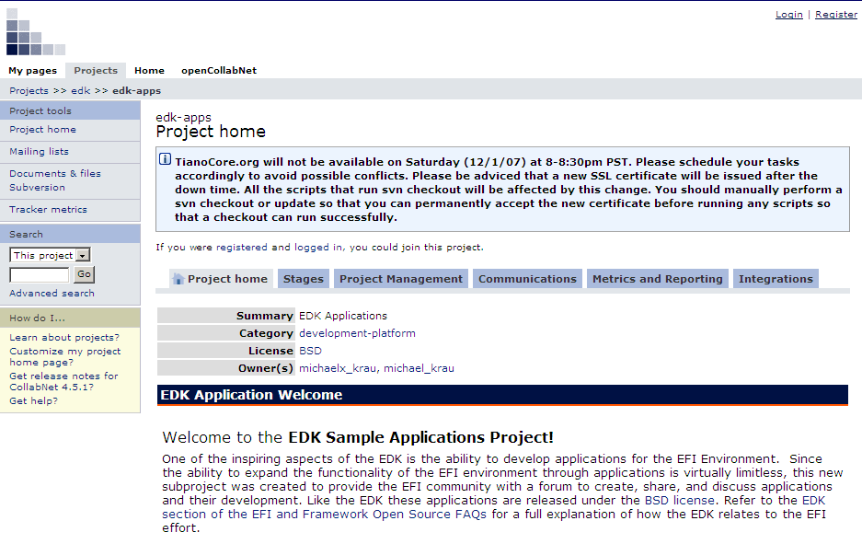
EDK Applications
EDK Sub-project http://edk-apps.tianocore.org
Notes:
Applications are code modules that can be built with the EDK and run in the Shell environment. Applications developed in the EDK can use the EFI Framework to perform many useful operations, from basic utilities (like editing, file manipulation, and user interfaces), to platform specific support (diagnostics, Protocol tests, device and driver inventory.
Of particular note, the EFI Shell contains many applications embedded in it operation, in fact, the shell it self is an application. However, the shell applications provided in the shell are considered the basic level of support for the shell environment. The applications contained in this project were developed beyond that scope (although it is possible to add new applications and an integrated part the shell).
EFI applications can be used for many is also a development kit for developing, debugging, and testing EFI and Framework drivers, EFI Option ROMs, and EFI Applications for use in the Framework environment. The following bullets provide information on how to download, build and use the EDK, Shell, and Sample Applications:

Slide 9
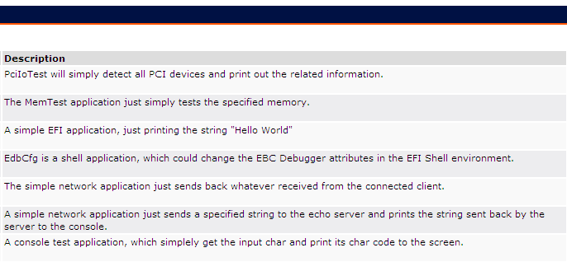
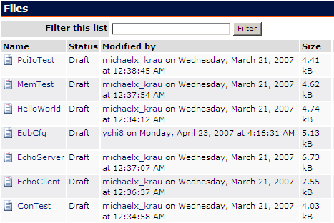
EDK-APPS Examples
Under Documents and Files

Slide 10
What is Developers UEFI Emulation (DUET)
EDK - DUET
DUET – UEFI Over Legacy BIOS
Why DUET?
  Provide IHV an EFI/UEFI environment above legacy BIOS, to help them develop and debug their native EFI/UEFI drivers.
Enter condition:
  Hardware Initialization done. Legacy interfaces available.
  Legacy boot to DUET.
Exit condition:
  Provide pure EFI/UEFI environment. (IA32/X64)
  Boot to EFI/UEFI Shell/OS.

Slide 11
Goal of DUET
EDK - DUET
Goal is …
  Export EFI/UEFI interface
  Support IA32 and X64 architecture
  Chipset/Platform independent
  Boot from Floppy
  Boot from USB (Legacy Free Consideration)
  Boot from Hard Disk
  Support boot to EFI/UEFI Shell

Slide 12
DUET Goal (Cont’d)
EDK - DUET
Goal is not:
  Not all Framework interfaces are supported, (for example: PEI-CIS, DXE-CIS)
  Not support Itanium® Processor architecture
  Not support CSM, INTx call (except Video), and 16bit code
  Not support boot to Legacy OS
  Not support boot to OS

Slide 13
EDK DUET
How to use DUET
DUET release notes on Tianocore.org:
  https://edk.tianocore.org/files/documents/16/320/DuetRelNotes.txt

Slide 14
EFI Toolkit Components
EFI Toolkit
Source Included
Utilities
C Library
Network Stack
Platform Management
Compression
Database
Useful tools for EFI
application development
Notes:
The EFI Toolkit that is currently available from the EFI Web site provides a rich collection of commonly used library routines.
The Toolkit includes sample applications and utilities to aid you in your development, an ANSI compliant C library (printf, scanf, …), a TCP/IP compliant network stack, platform management routines like an SMBIOS library, a compression library and a some database utility libraries.
Source code to all the mentioned features is provided with the library and is under the Free-BSD licensing model. Thus you can freely use the libraries in your shipping products and change the source without the need to provide royalties or your changes back to us.

Slide 15
Programming Models
EFI Toolkit
Native EFI Model
  Uses only EFI constructs
  Access to all EFI constructs
  Smaller code size
Portability Model
  Familiar programming interfaces
  Easier to port ANSI/POSIX based programs
  Larger binary image
A single program can use both
Notes:
3 programming models can be used with the Toolkit. All models allow access to the EFI interfaces.
The first model provides the smallest code size option and uses the “lite-weight” version of the C library.
The portability model uses the ANSI/POSIX compliant libraries to allow porting of existing programs quickly. This will result in a larger binary image since all the code for example “printf” is included in your application. The toolkit does not provide a shared library model. However you can remove certain portions of the library that you don’t need to decrease the size. For example you could remove the floating point support in the print routines since typically they are not used.
The last model is a combination of the first two – where you combine ANSI/POSIX library routines with the lighter weight and native EFI interface calls.

Slide 16
EFI Toolkit Integration
EFI Toolkit
Utilities
C Library
Network
Compress
Management
Database
EFI API
EFI
Hardware
Notes:
Here we show how the EFI Toolkit is integrated with the firmware. The toolkit components integrate directly with the EFI interface, this provides portability across architectures. For example the “printf” routine will end using the TextOut EFI protocol to send characters to an output device.

Slide 17
C Library
EFI Toolkit
FreeBSD Port
ANSI/POSIX compliant
System I/O - open(), read(), write(), close(), stat()
Standard I/O - fopen(), printf(), gets(), …
String/Char - strcmp(), isascii(), atoi(), …
Memory - malloc(), free(), realloc(), …
Time/Date - time(), asctime(), ctime(), …
Math - sqrt(), pow(), sin(), log(), …
Notes:
The C Library is a port of the FreeBSD C Libraries and provides the commonly used ANSI and POSIX routines such as system I/O, Standard I/O, String routines, memory allocation/deallocation, time and date routines, and math routines. It should be noted on the math routines these have not been optimized to use the math coprocessor intrinsic functions – the routines are written in C for portability.

Slide 18
EFI Library
EFI Toolkit
“Lite Weight” C Library like functions
  String Functions
  Memory Support Functions
  CRC Support Functions
  Text I/O Functions
  Math Functions
  Spin Lock Functions
Specific EFI functions
  Handle and Protocol Support Functions
  Device Path Support Functions
Notes:
As mentioned earlier, there is a lite-weight version of the C Library functions that provide equivalent functionality to many of the ANSI/POSIX routines. Their interfaces are slightly different to preserve the namespace and allow the mixing of the ANSI/POSIX routines.
Also included are specialized or helper routines for managing various handle, protocol and device paths used within EFI.

Slide 19
Network Components
EFI Toolkit
Port of FreeBSD TCP/IP stack
Supports standard protocols
  IPv4, ICMP, ARP, UDP, TCP
Socket library interface
Implemented as an EFI protocol
Notes:
Included in the network support is a port of the FreeBSD TCP/IP stack. Thus you have support for all the familiar protocols including IPv4, UDP and ARP.
A socket library is provided to ease in the porting of existing network applications/utilities to the EFI platform.
If you don’t use the socket library, the network protocols can be accessed via EFI protocols.

Slide 20
Miscellaneous
EFI Toolkit
SMBIOS Library
  Library routines for parsing SMBIOS tables
Database
  btree
  Hashing
Compression
  General purpose compression/decompression
  Gzip functionality
Notes:
Some of the other components of the toolkit are:
An SMBIOS library routines for parsing SMBIOS tables
Database routines including a btree database and various hashing functions
A compression library that provides GZIP compression/decompression routines

Slide 21
Utilities
EFI Toolkit
Network utilities
  FTP client and server, ping
Text editor
Scripting interpreter (Python)
Sample applications
Notes:
To aid you in using the library, various sample applications and commonly used/needed applications are provided. They include network utilities such as an FTP client and server, a full screen text editor, and the Python scripting interpreter. Full source code is provided for all of these

Slide 22
EFI Hello.c
EFI Toolkit
  #include "efi.h"
  EFI_STATUS
  InitializeHelloApplication (
  IN EFI_HANDLE ImageHandle,
  IN EFI_SYSTEM_TABLE *SystemTable
  )
  {
  UINTN Index;
  SystemTable->ConOut->OutputString(SystemTable->ConOut,
  L”Hello application started\n");
  SystemTable->ConOut->OutputString(SystemTable->ConOut,
  L"\n\r\n\r\n\rHit any key to exit this image\n\r");
  SystemTable->BootServices->WaitForEvent(
  1, &(SystemTable->ConIn->WaitForKey), &Index);
  SystemTable->ConOut->OutputString(SystemTable->ConOut,
  L"\n\r\n\r");
  return EFI_SUCCESS;
  }
Notes:
In the next couple of slides I will show you sample applications using the different library models.
Here we have an application the is pure EFI. It looks very similar to an EFI driver in that you have the same entry point as drivers do with a pointer to the EFI system table and the applications image handle. This application prints lines to the console and then waits for a key to be pressed.

Slide 23
EFI Library Hello.c
EFI Toolkit
#include "efi.h"
  #include "efilib.h"
  EFI_STATUS
  InitializeHelloLibApplication (
  IN EFI_HANDLE ImageHandle,
  IN EFI_SYSTEM_TABLE *SystemTable
  )
  {
  InitializeLib (ImageHandle, SystemTable);
  Print(L"\n\n\nHelloLib application started\n\n\n");
  Print(L"\nHit any key to exit this image\n");
  WaitForSingleEvent(ST->ConIn->WaitForKey,0);
  ST->ConOut->OutputString (ST->ConOut, L"\n\r\n\r");
  return EFI_SUCCESS;
  }
Notes:
This example uses the EFI lite-weight toolkit functions in place of some of the native EFI protocols. To use this library you must pass your handle and EFI system table pointer so that it can initialize its internal variables. As you see you can still mix native EFI protocol usage with the lite-weight function calls like “Print()”.

Slide 24
C Library Hello.c
EFI Toolkit
  #include <atk_libc.h>
  #include <stdio.h>
  EFI_STATUS
  InitializeHelloLibCApplication (
  IN EFI_HANDLE ImageHandle,
  IN EFI_SYSTEM_TABLE *SystemTable
  )
  {
  InitializeLib(ImageHandle, SystemTable);
  printf("Hello LibC application started\n\n\n");
  printf("Hit C/R to exit this image\n");
  return( getchar() );
  }
Notes:
Here we show an example of using the ANSI/POSIX library. In this case all of the EFI protocols were replaced with printf() and getchar().
The header file “atk_libc.h” includes the header files for making EFI calls – “efi.h”.

Slide 25
C Library Hello.c
EFI Toolkit
  #include <atk_libc.h>
  #include <stdio.h>
  int main (int argc, char **argv )
  {
  printf("Hello LibC application started\n\n\n");
  printf("Hit C/R to exit this image\n");
  return( getchar() );
  }
Notes:
In the last example we show the most portable application that uses the standard entry point of “main”. The entry point to the application is included in a library routine that initializes the runtime library and then calls the main routine. Upon exit it then returns back to the EFI loader as in the previous examples.

Slide 26
C++ Support
EFI Toolkit
No direct support
  No Global constructors and destructors
New and Delete can be mapped to malloc/free
Notes:
Usage of the C++ language to write EFI applications is supported with a few caveats:
Currently there is not compiler prologue/epilogue support for global constructors and destructors. These are compiler dependent and since the EFI core does not use C++, support has never been provided. You can provide initialization of these yourself.
For new and delete function support, these can simply be mapped to malloc/free.

Slide 27
Portable Embedded Graphics
3rd Party Support
Portable Embedded Graphics
  Portable graphics library for EFI
  Similar windowing components (widgets)
    Dialog boxes
    Progress bars, scroll bars
    Text boxes
    Window Management
    Fonts
    Bitmaps, JPEG, …
Contact Swell Software
  http://www.swellsoftware.com
Notes:
The company Swell Software has a portable graphics library that has been ported to use the EFI UGA interface. The library is very compact and configurable to provide common windowing components or widgets used in today’s graphic user interfaces.
These include dialog boxes, progress and scroll bars, text boxes, windows, font support and routines for displaying graphical images. It is fairly complete and was used to develop a HTML viewer that runs on EFI.

Slide 28
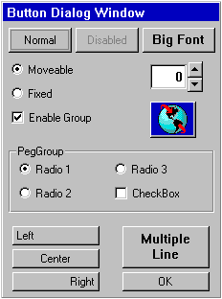
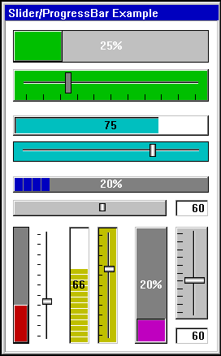
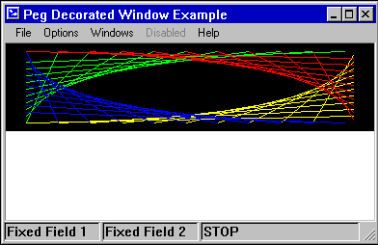
PEG Components
3rd Party Support
Notes:
Here is an example of some of the widgets that are available with the PEG library. These widgets can be used in your EFI application to give it that “non-BIOS” look.

Slide 29
Summary
EFI Applications extend firmware
  Provides system independence in the pre-boot space
    Hardware
    Operating System
    Platform
      Intel® IA-32, EM64T, Itanium® Architecture and XScale® technology
Large library support
EFI Shell provides convenient launch point
Notes:
In summary I have talked about how EFI applications can be used in the pre-boot space to extend the capabilities of the firmware. They can be used to provide pre-boot diagnostics for the end user or the manufacturing line or possibly platform setup.
Being portable across different architectures supporting EFI, they provide hardware-independence for the pre-boot environment.
To assist in the development of these application, rich library support is provided.
The EFI shell provides a convenient launch point for these applications – although you are not restricted to using the EFI shell to launch your EFI applications.

Slide 30
Further Information
https://www.TianoCore.org
  Website for EFI open source resources
    EFI Developer Kit (EDK)
      Nt32 emulation environment
      EDK-APPS https:/edk-apps.tianocore.org/
    EFI toolkit https://efi-toolkit.tianocore.org/
http://www.swellsoftware.com
  Portable Embedded Graphics toolkit

Slide 31




Q & A

Slide 32


Slide 33

Back up
Back Up

